Slide 1
BEHAVIORAL HEALTH IN THE SOCIAL CONTEXT
Strengthening Emerging Community Partnerships Between Behavioral Health & Aging Services
College of Holly Cross, Worcester
June 28th, 2018
_{Gerontology Institute}
University of Massachusetts Boston

Slide 2
1
INTRODUCTION TO
HEALTHY AGING DATA REPORT
https://healthyagingdatareports.org
Chae Man (Jay) Lee, PhD
Chaeman.lee@umb.edu

Slide 3
Tufts Health Plan Foundation

Slide 4
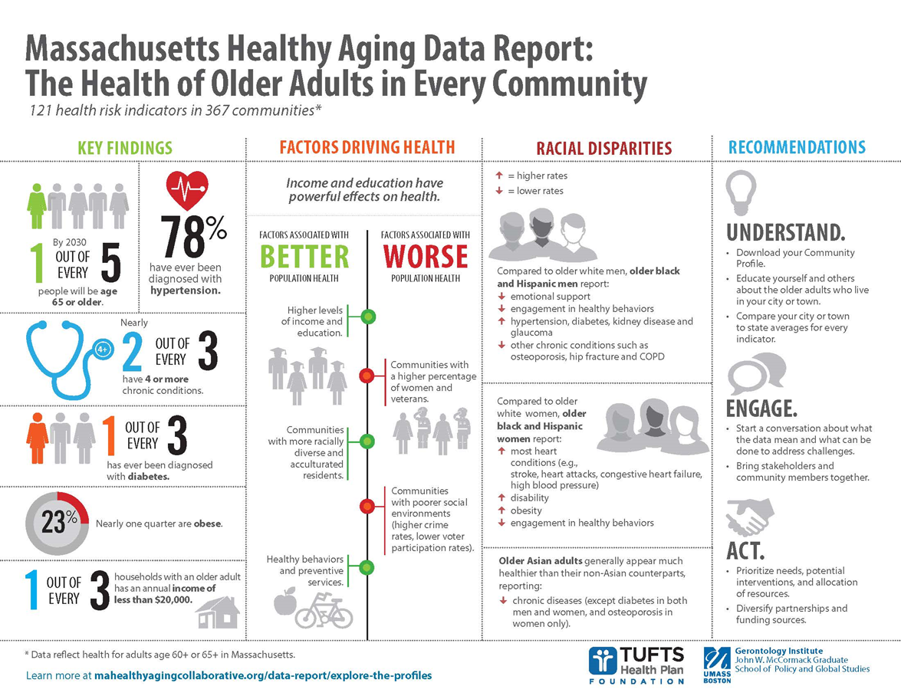
MA Healthy Aging Data Report 2014, 2015, & 2019 (forthcoming)
Notes:
Here is a one page infographic summarizes the finding of the report. You can download this at the website.

Slide 5
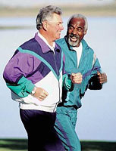
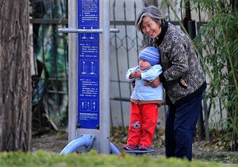
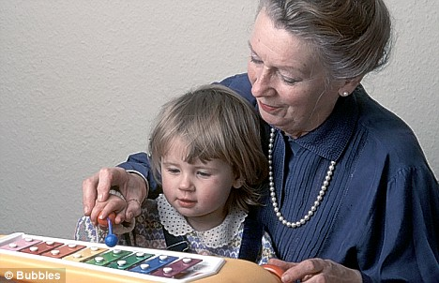
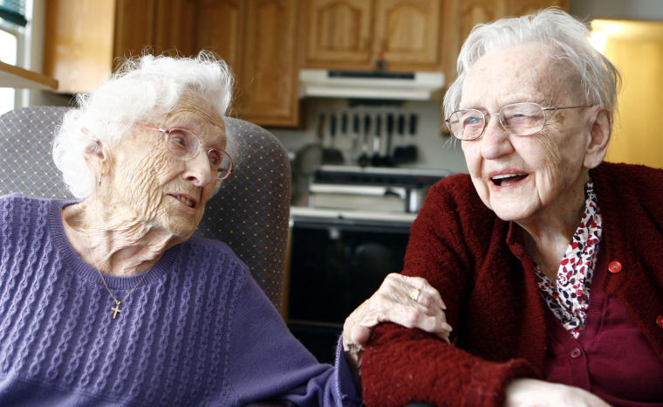
Data Sources
Centers for Medicare and Medicaid Services (CMS)
American Community Survey (ACS)
Behavioral Risk Factor Surveillance System (BRFSS)
MA Department of Public Health
MASS DOT
MA Secretary of Election Division
The Elder Economic Security Standard™ Index
Federal Bureau of Investigation Uniform Crime Reports
Area Health Resources File
Walkscore.com
Primary data collection on selected community resources
Fatality Accident Reporting System
Environmental Protection Agency
Notes:
This is a list of data sources that we used for our report.

Slide 6
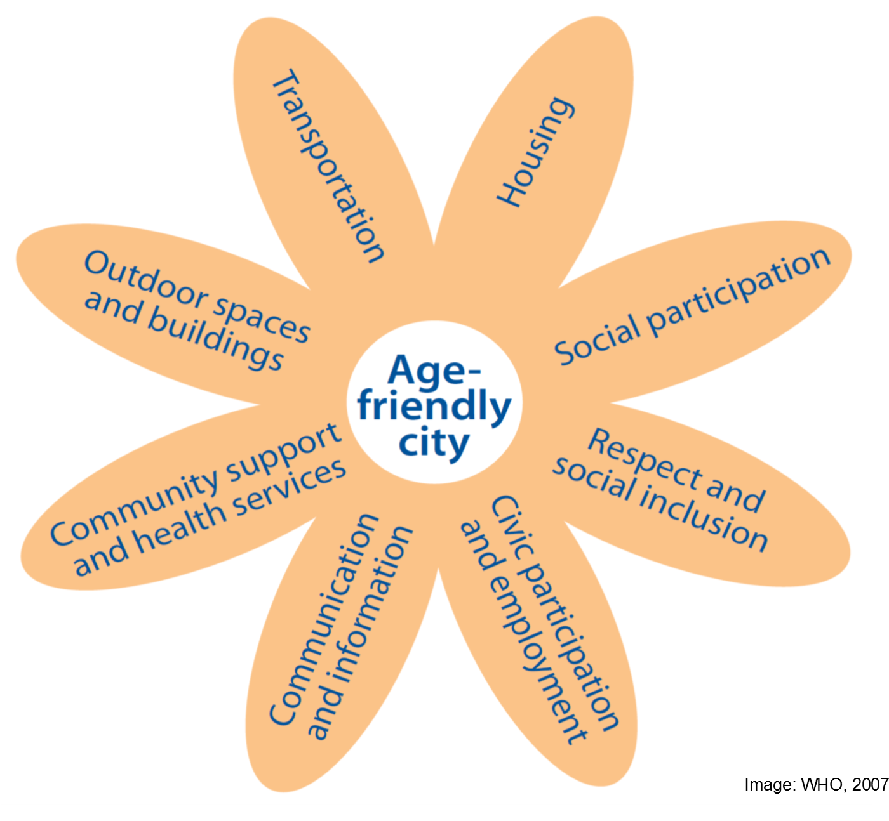
Community Profiles
Population Characteristics
Wellness/Prevention
Nutrition/Diet
Mental Health
Chronic Disease
Disability
Access to Care
Service Utilization
Community Variables/Civic Engagement
Safety/Transportation
Economic
Notes:
There are about 180 variables we have used for the report, which can be nicely mapped into the age-friendly model. Example….

Slide 7
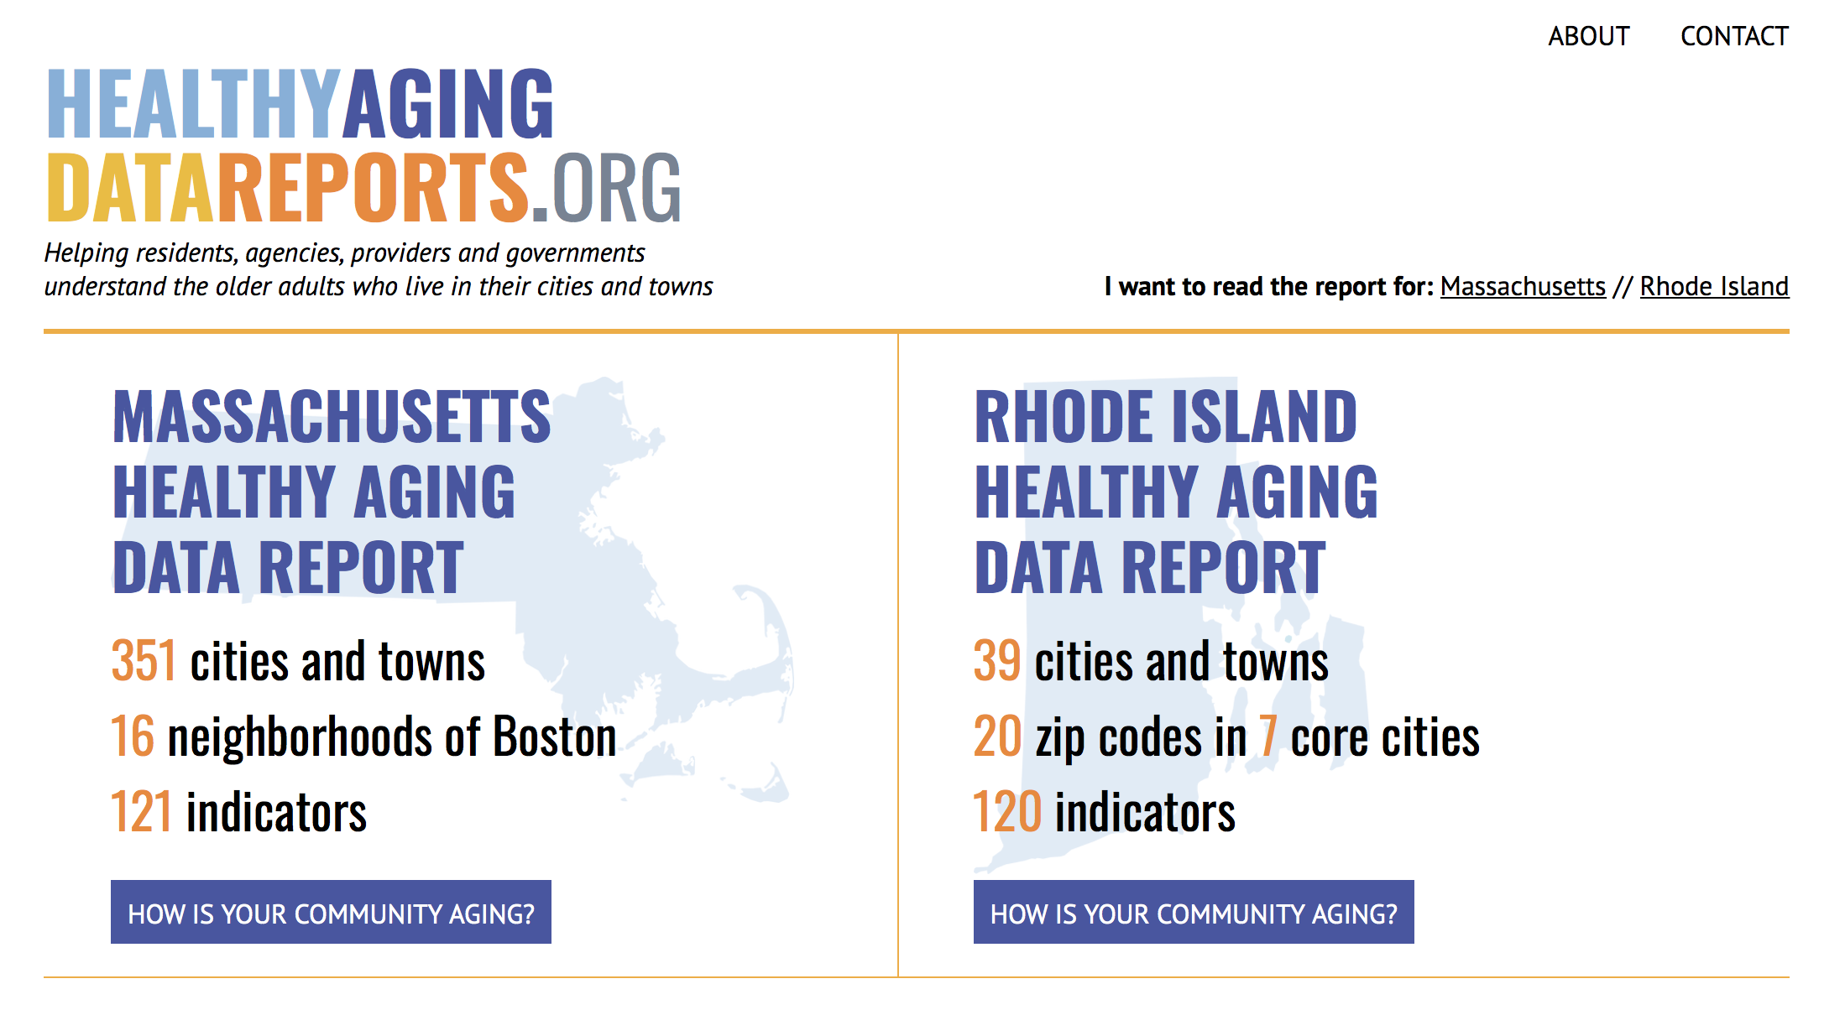
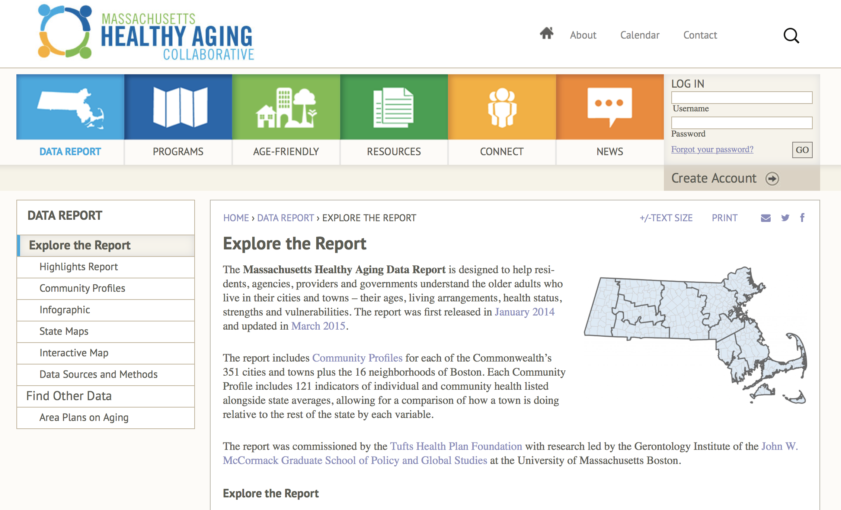
Data Report Website https://healthyagingdatareports.org
Notes:
Take Worcester as an example. Next, I will give the stage to Wendy to describe the findings.

Slide 8
Acknowledgement
Executive Office of Elder Affairs
Researchers from the Gerontology Institute, University of Massachusetts Boston
Elizabeth Dugan, PhD
Frank Porell, PhD
Nina M. Silverstein, PhD
Chae Man Lee, PhD
Shuangshuang Wang, PhD
Bon Kim, ABD
Shiva Prasad, MS
Natalie Pitheckoff, PhD candidate, MGS
Haowei Wang, PhD candidate, MS
Massachusetts Councils On Aging
Tufts Health Plan Foundation
Notes:
Adding Highway

