Slide 1
“Beefing Up Your Tool Kit”
Mental Health First Aid

Slide 2
Trauma Informed Care Seeks to___
Realize the widespread impact of trauma and understand paths for recovery
Recognize the signs and symptoms of trauma in patients, families, and staff
Integrate knowledge about trauma into policies, procedures and practices
Actively avoid re-traumatization
Trauma informed care can help improve patient outcomes

Slide 3
Oklahoma City Bombing of the Murrah Building- April 19, 1995 – 168 deaths
This Photo by Unknown Author is licensed under CC BY-NC-ND
This Photo by Unknown Author is licensed under CC BY

Slide 4
September 11, 2001 2,997 deaths..Countless others as a result of the toxicity of the conditions…
This Photo by Unknown Author is licensed under CC BY-NC-ND
This Photo by Unknown Author is licensed under CC BY-NC-ND

Slide 5
September 11, 2001 Continued
The Pentagon
Shanksville, PA

Slide 6
Where were you?

Slide 7
Boston Bombing April 15, 2013 Four deaths….
This Photo by Unknown Author is licensed under CC BY
This Photo by Unknown Author is licensed under CC BY

Slide 8
Images
The images that I have just shown you I am certain conjure up feeling of these events that are still very real for all of us
The impact of the media during events such as this
The need to be plugged in, especially the population that we serve
The need to process
Pandemic – Lack of ability to process – cut off from society

Slide 9
What Is Trauma?
Trauma results f rom exposure to an incident or series of event that is emotionally disturbing or life-threatening.
Examples of events that may be traumatic include:
Physical, sexual, and emotional abuse
Childhood neglect
Having a family member with a mental health or substance use disorder
Violence in the community
Natural or human-made disasters and forced displacement
Sudden unexplained separation from a loved one
Poverty and discrimination

Slide 10
Aftermath of Trauma
Traumatic events can impair our ability to grasp or cope with what is happening, which can lead to a slew of challenges such as sadness, grief, pain, panic, confusion, despair, anxiety, depression, and more (Aydin, 2017). As Judith Herman (1992) states in her book about recovering from the aftermath trauma, “Traumatic events are extraordinary, not because they occur rarely, but rather because they overwhelm the ordinary human adaptations to life." In a time of trauma, our nervous systems can become overwhelmed in trying to process the experience which can lead to unexpected and undesired difficulties.

Slide 11
Shifted Focus
Trauma informed care shifts the focus from “What’s wrong with you?” to What happened to you?”
A trauma informed approach to care acknowledges that health care organizations and care teams need to have a complete picture of a patient’s life situation – past and present – in order to provide effective health care services with a healing orientation.
Adopting trauma-informed practices can potentially improve patient engagement, treatment adherence, and health outcomes, as well as provider and staff wellness.

Slide 12
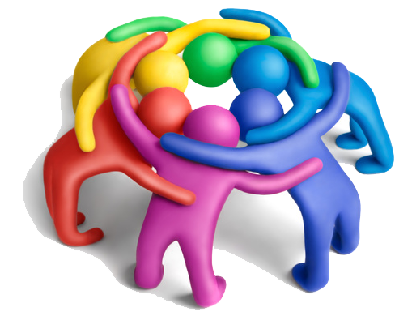
Collective Trauma
Not only can individuals experience trauma on their own, but entire groups of people and societies can collectively suffer from traumatic experiences. When trauma reaches a level where it negatively impacts entire societies or groups of people, it is called collective trauma. Situations that may lead to collective trauma include war, mass violence, genocide, and pandemics

Slide 13
Trauma Defined
Trauma overwhelms a person’s coping capacity and has long-term effects on functioning and well-being
Normal protective responses to threats (fight, flight or freeze) are activated by the perception of a threat
A person who has experienced trauma may continue to experience this defensive response even in situations that are not threatening

Slide 14
Universal Definition
There is no universal definition of Trauma. However, the Substance Abuse and Mental Health Services Administration describe trauma as resulting from “an event, series of events, or set of circumstances experienced by an individual as physically or emotionally harmful or life-threatening with lasting adverse effects on the individual’s functioning and mental, physical, social, emotional or spiritual well-being.
This Photo by Unknown Author is licensed under CC BY-SA

Slide 15
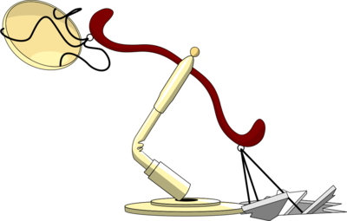
Relationship between Trauma and health –risk behaviors
Sometimes these strategies involved maladaptive behaviors, such as unhealthy eating, tobacco use, or drug and alcohol use. These coping mechanisms may provide relief, but they can also simultaneously contribute to anxiety, social isolation and chronic disease.

Slide 16
Impact of Trauma on Relationships
Traumatic experiences impact relationships
The relationships between people, communities, and the delivery systems that support individuals’ health and social needs
When a person experiences trauma, he or she may feel unsafe, betrayed, and/or have difficulty trusting others. This can lead to heightened emotions, such as anger or aggression, or a tendency toward shame, numbing and/or isolation.
Within health care, you can see how this can negatively impact the bond between patient and provider, and thus a patient’s engagement in care

Slide 17
Not all gloom and doom
Protective factors, such as supportive relationships with family members, a teacher, or others in the community, can help shield individuals from the effects of trauma and build resilience to help overcome adversity and confront challenges.
Trauma-informed approaches to care, include relational healing and trauma specific treatments, can help patients begin processing their experiences in a healthy way.

Slide 18
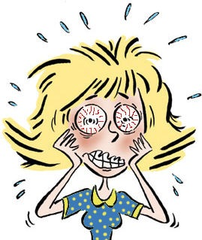
COVID-19
It is understandable the COVID-19 Pandemic is likely to cause significant stress and psychological distress for a large portion of the population and the rates are progressively increasing.
I am not sure if you caught the evening news last night but Michelle Obama shared with the nation that she herself is experiencing some low level depression as a result of the pandemic.

Slide 19
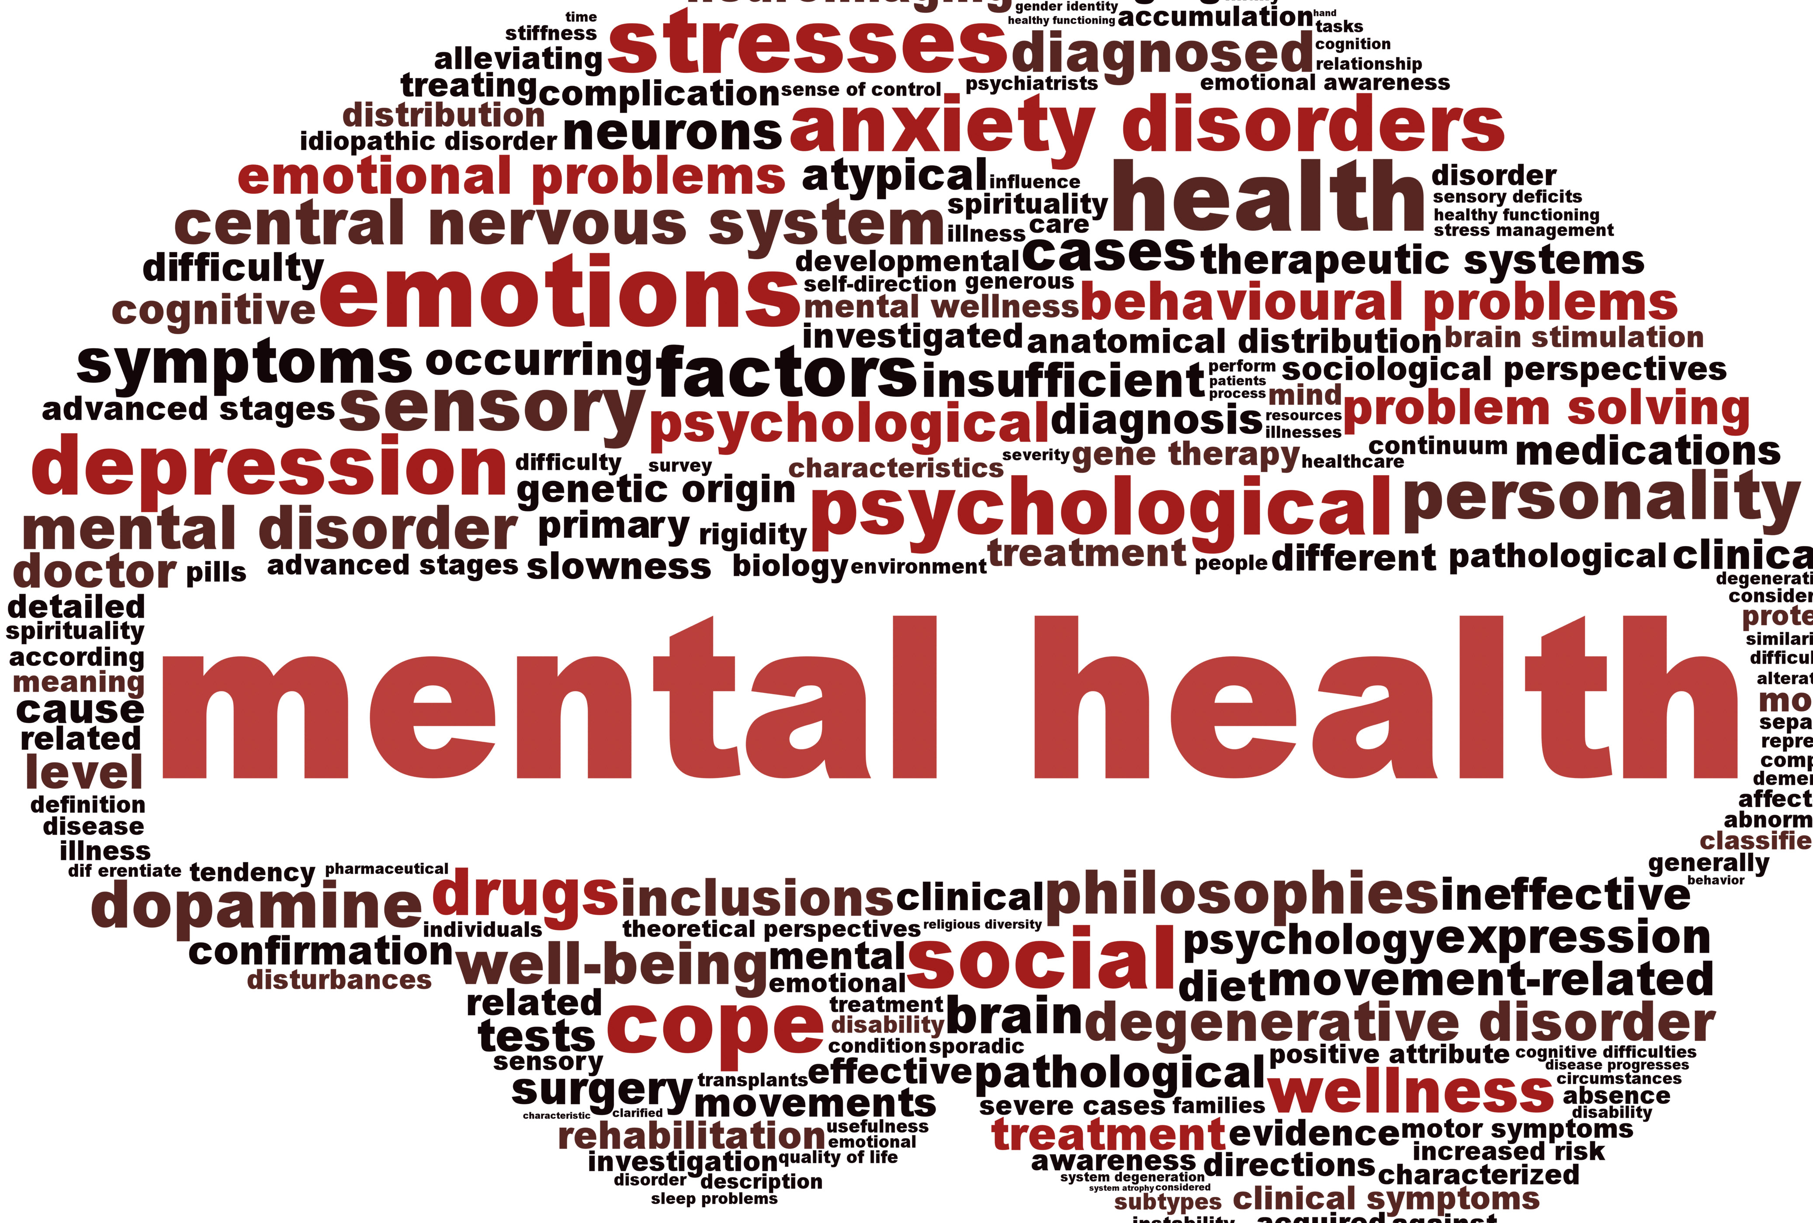
COVID-19
COVID-19 is having a huge impact on the nations mental health. In April, the Kaiser Family Foundation reported that nearly half of Americans said they felt emotionally impacted by the pandemic, while the American Foundation for Suicide Prevention noted that people are experiencing anxiety and sadness more than before the pandemic began in late winter

Slide 20
COVID-19
Experts call it the underlying crisis. While COVID-19 spikes around the country, more than 1/3 of Americans report related depression and anxiety. These and other mental conditions are becoming amplified during this crisis.
The spread of COVID-19 leaves people feeling out of control, which is uncomfortable and unnerving. We’re driven to protect ourselves and loved ones from perceived threats and the uncertainty surround the situation escalates fears.

Slide 21
During the AIDS crisis in this country Universal and Standard Precautions became a very important part of health care providers standards…the bottom line of those precautions was that we were to treat everyone as though they were infected, because in reality you never knew who was
In the journey through this pandemic, we need to be that aware of the prevalence of trauma and treat everyone as though that is a real part of who they are

Slide 22
Pandemic Fall Out
As the COVID-19 pandemic spreads across the globe, and is very much in our own backyards, we are amidst a time of uncertainty and upheaval.
Where the focus may often be on recognizing COVID-19 symptoms during this time, it is also important to recognize that this time of crisis and trauma may lead to mental health challenges for many.
What are the mental health consequences of a pandemic and how do we cope when there is much that is out of our control?

Slide 23
Pandemic = Crisis
Its important to call it what it is and not try to sugar coat or minimize it. When we minimize things we take a real lunge toward insulting the average person’s intelligence.
First, it is important to acknowledge that a pandemic is considered a crisis, and in turn, can be traumatizing.
The trauma can happen as a result of a number of different very real variables…perhaps someone has contracted the virus themselves, maybe they are close to someone who has, maybe they have lost a loved one as a result of the crisis….whatever the situation the result can be very real chaos.
the upheaval of a widespread health crisis can be traumatic.

Slide 24
Important Images

Slide 25
It’s ok to not feel ok
“This is a stress affecting all of us in one way or another to different degrees, and once we acknowledge that to ourselves and to others, we can start looking for strategies and resources for treatment and better health” – Dr. Fava – Mass General

Slide 26
YOU

Slide 27
Tool Kit essentials
Some tips for taking care of your mental health and the mental health of others during the COVID-19 pandemic may be:
Stay connected with people. Even if the times necessitate quarantine or social distancing, get creative in ways to stay connected to others. Technology can be a great resource when physical proximity is not an option.

Slide 28
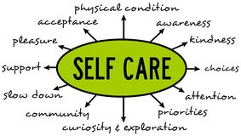
Tips Continued
When all else fails, remember the basics. Be sure to get enough sleep, eat well, and exercise. Research demonstrates that these basic daily tasks support our brains in coping effectively, regulating stress, decreasing depression and anxiety symptoms, and processing information.

Slide 29
Tips Continued
Just as you would create a medical toolkit, create a coping toolkit for yourself. Put together a list or kit of activities and objects that help you feel grounded, safe, bring you joy, and increase your quality of life as you ride out this crisis.

Slide 30
Tips Continued
Although staying informed is important, as possible, minimize your exposure to media on the outbreak and/or the flooding of traumatic stories about the pandemic. Exposure to trauma-filled media has been linked with increases in vicarious traumatization and traumatic stress symptoms.

Slide 31
Final Tip
If all else fails, normalize your struggles. Remember that you are not alone in this and many others are dealing with the consequences of this distressing time. Be kind to yourself (and others). Kindness and compassion can go a long way.

Slide 32
Resources
-Hartford Healthcare.org
NAMI
Mass General.org
Center for Disease Control
Channel Five Evening News

