Slide 1
Welcome!
This is the COA Annual Report webinar.
We will be getting started shortly.
Please note:
All attendees have been muted on entry.
You are welcome to ask a question through the chat function at any time during the webinar, and we will unmute people to ask questions at certain points during the webinar.
This slide deck will be distributed via email after this meeting.

Slide 4
COA Annual Report
History and Purpose
Required by the Massachusetts statute establishing COAs
(MGL Part I, TitleVII, Chapter40, Section8B)
Helps EOEA and EOHHS identify trends, strengths and gaps in service
Provides Commonwealth officials with detailed information on town activity

Slide 5
COA Annual Report
Submission
https://app.keysurvey.com/f/41597644/92a8/
Online submission allows for easy completion and analysis of data
Questions are the same as previous years
Paper copy or My Senior Center report acceptable
Due January 31, 2022

Slide 6
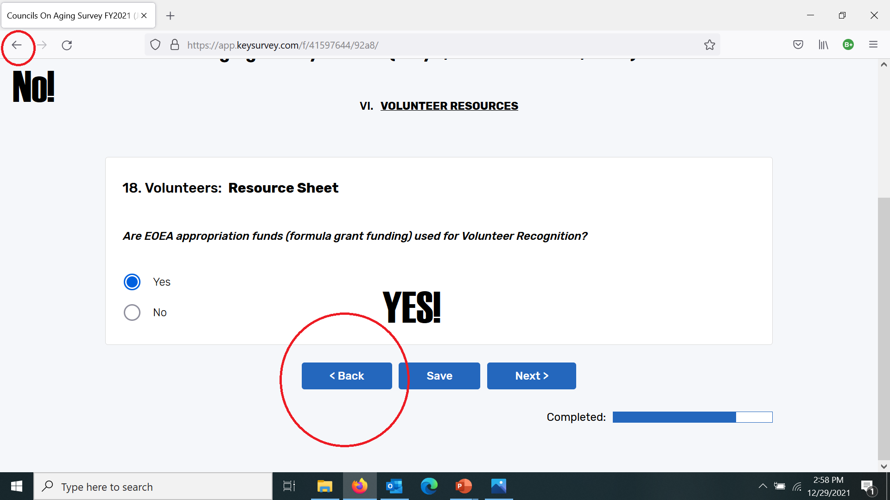
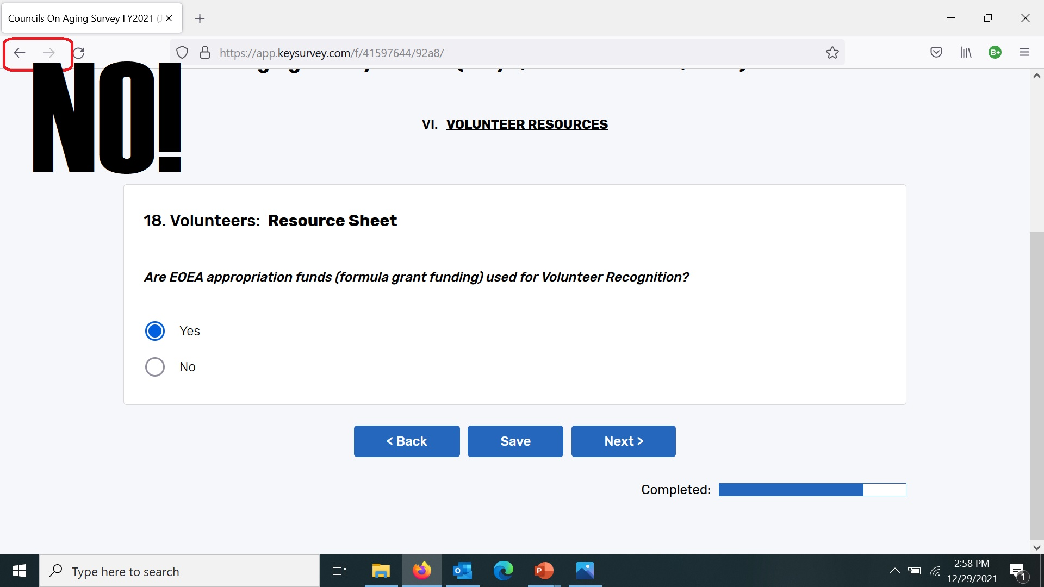

Slide 7
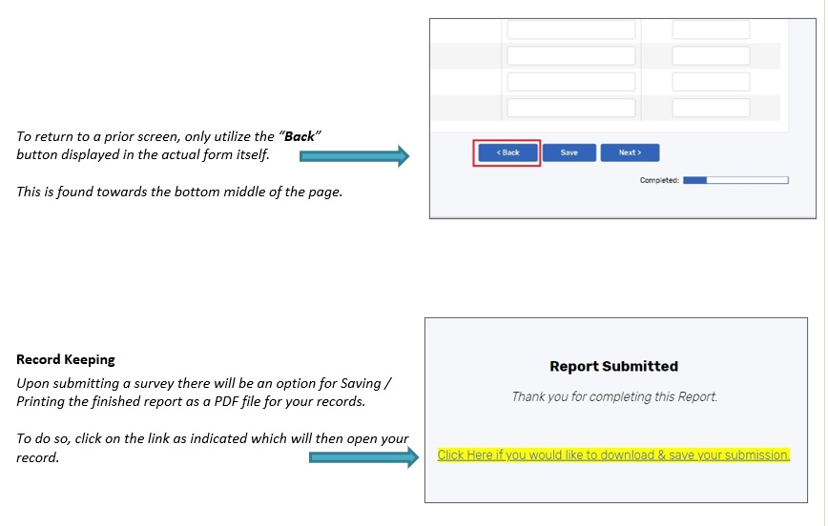

Slide 8
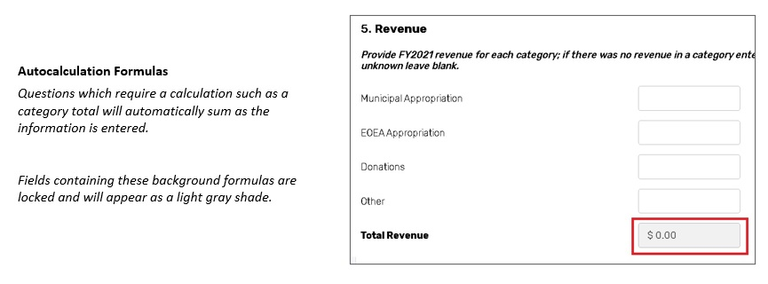

Slide 9
Walk Through / Q&A
https://app.keysurvey.com/f/41597644/92a8/

Slide 10
CONTACTS Massachusetts Executive Office of Elder Affairs
Adam Frank
COA Program Coordinator
adam.frank@mass.gov
(617) 222-7428
Michael Venditto
Research and Data Analyst
michael.venditto@mass.gov
(617) 222-7467
Carole Malone
Assistant Secretary
Carole.Malone@mass.gov
(617) 222-7568

